Slide 1

Text Classification and Sentiment

Slide 2
Contents
Text Classification
Navie Bayes to Text Classification
Navie Bayes Algorithm
Sentiment Analysis (SA)
Navie Bayes to SA
Evaluation Metrics

Slide 3
Text Classification
Define
Text classification is the task of categorizing or assigning predefined labels or categories to text documents based on their content.
The goal is to develop algorithms or models that can automatically determine the most appropriate category for a given piece of text, enabling efficient organization and analysis of large volumes of textual data.

Slide 4
Text Classification
Relevance of Text Classification
Spam Detection
  Identifying and filtering out unwanted or unsolicited emails, messages, or comments.
Sentiment Analysis
  Determining the sentiment or emotion expressed in text, such as positive, negative, or neutral sentiments in customer reviews or social media posts.
Topic Categorization
  Grouping documents into topics or subjects, aiding in content organization and retrieval.
Language Identification
  Determining the language in which a text is written.
News Categorization
  Organizing news articles into relevant categories like politics, sports, entertainment, etc.
Document Classification
  Sorting legal documents, research papers, or any textual data into predefined categories.

Slide 5
Navie Bayes to Text Classification
Naive Bayes is a powerful and widely used algorithm for text classification. It's based on the Bayes' theorem, which calculates the probability of a certain event occurring based on prior knowledge of related events.
In the context of text classification, Naive Bayes assumes that the presence of a particular word in a document is independent of the presence of other words. This is a simplification, as words in a text often have contextual relationships. However, despite this "naive" assumption, the algorithm often works well in practice, especially for tasks like spam detection and sentiment analysis.

Slide 6
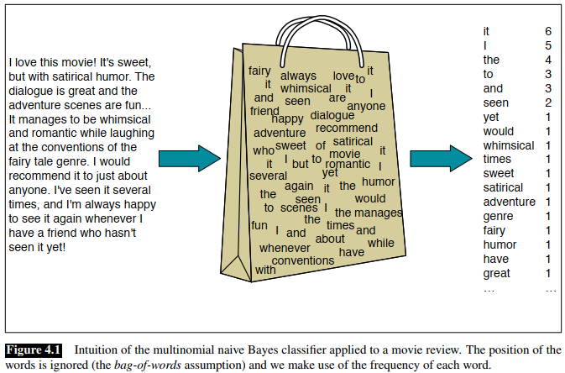
Navie Bayes Algorithm

Slide 7
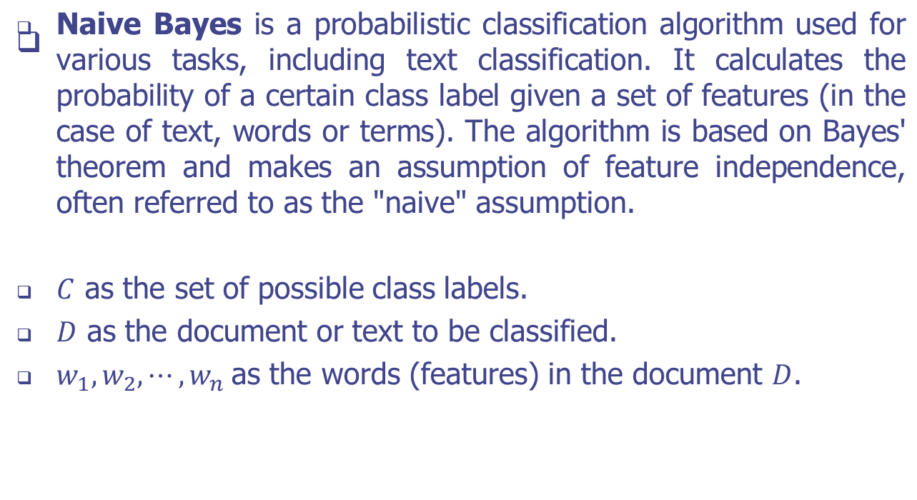
Navie Bayes Algorithm

Slide 8
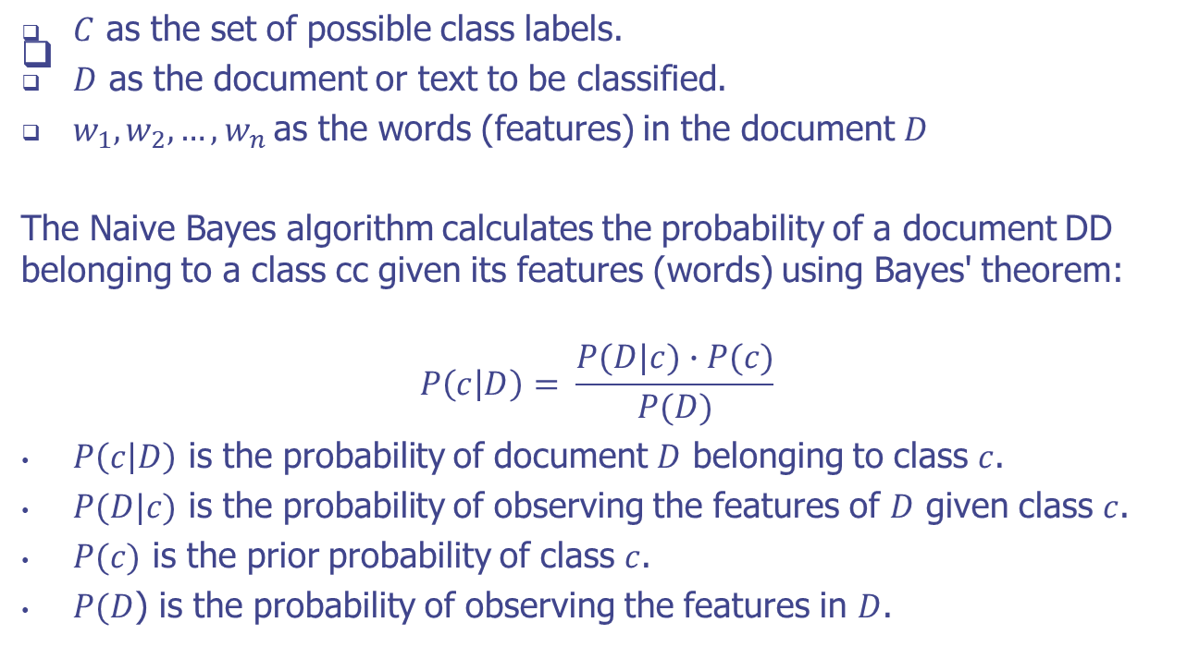
Navie Bayes Algorithm

Slide 9
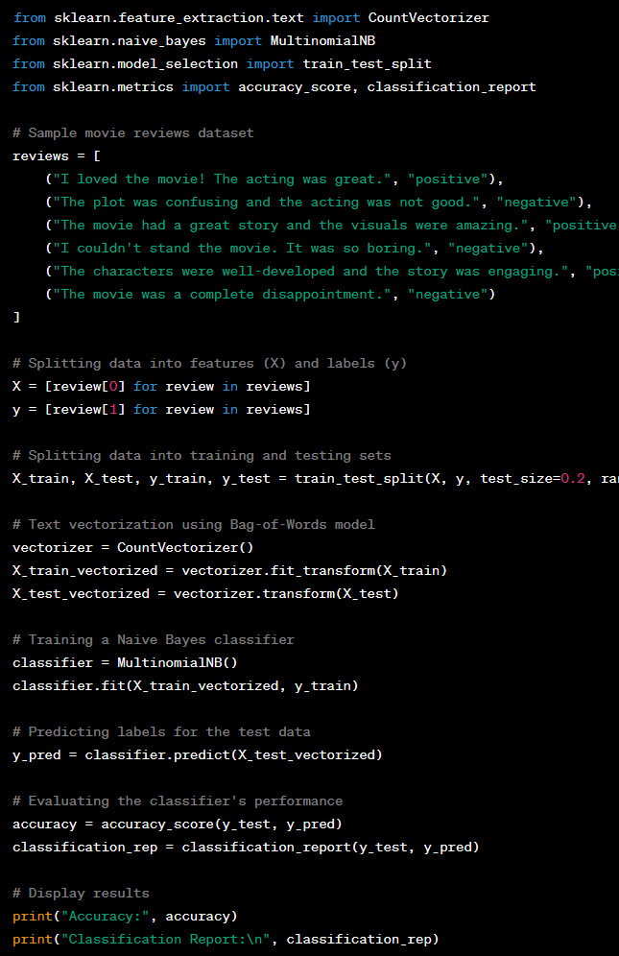
Example
In this example:
We have a small dataset of movie reviews, each labeled as "positive" or "negative.“
We use the CountVectorizer to convert the text data into a numeric representation (Bag-of-Words model).
A Naive Bayes classifier (MultinomialNB) is trained on the training data.
The trained classifier predicts the labels for the test data.
We evaluate the classifier's performance using accuracy and a classification report.

Slide 10
Sentiment Analysis (SA)
Sentiment analysis, also known as opinion mining, is the process of analyzing a piece of text to determine the sentiment, emotion, or attitude expressed within it.
The goal is to identify whether the text conveys a positive, negative, or neutral sentiment, and sometimes to further classify emotions like joy, anger, sadness, etc.

Slide 11
Sentiment Analysis (SA)
Importance of Sentiment Analysis
  Understanding Public Opinion
  Customer Feedback Analysis
  Social Media Monitoring
  Brand Management
  Market Research
  Political and Social Analysis
  Crisis Management
  Investor Relations
  Product Launch and Campaign Evaluation

Slide 12
Navie Bayes to SA
Training the Naive Bayes Model
  Data Preparation: The first step is to gather a labeled dataset containing text samples along with their sentiment labels. These labels could be binary (positive/negative) or include additional sentiment categories.
  Feature Extraction: For text data, features are typically words or terms. Each word becomes a feature, and the presence or absence of a word in a text is a binary feature. The text is preprocessed, which involves steps like tokenization (breaking into words), removing stop words (common words like "the," "and"), and stemming (reducing words to their base form).
  Creating the Training Data: From the labeled dataset, the algorithm calculates the frequency of each word in each sentiment category. This information forms the basis of the probabilities needed for classification.

Slide 13
Navie Bayes to SA
Training the Naive Bayes Model
  Calculating Class Probabilities: The prior probabilities of each sentiment class are calculated based on the frequency of documents in each class. For example, P(positive)P(positive) is the ratio of positive documents to the total number of documents.
  Calculating Word Probabilities: For each word in the vocabulary, the algorithm calculates the probabilities of that word occurring in each sentiment class. This is done by counting how many times the word appears in documents of each sentiment class and dividing by the total number of words in documents of that class.

Slide 14
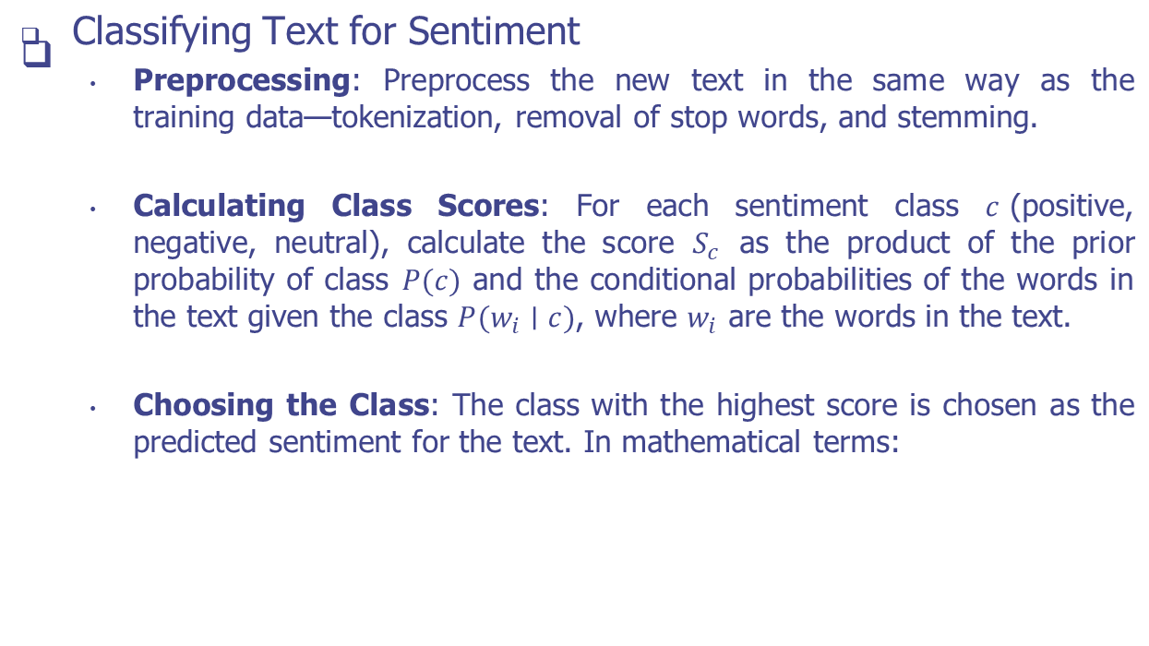
Navie Bayes to SA

Slide 15
Evaluation Metrics
Accuracy: Accuracy measures the proportion of correctly classified instances out of the total instances. While it's a straightforward metric, it might be misleading in cases of imbalanced datasets where one class dominates.
Precision: Precision quantifies the ratio of correctly predicted positive instances to all instances predicted as positive. It indicates the model's ability to avoid false positives.
Recall (Sensitivity or True Positive Rate): Recall calculates the ratio of correctly predicted positive instances to all actual positive instances. It shows the model's effectiveness in capturing all positive instances.

Slide 16
Evaluation Metrics
F1-Score: The F1-score is the harmonic mean of precision and recall. It balances both metrics and is especially useful when class distribution is imbalanced.
Confusion Matrix: A confusion matrix is a tabular representation of the model's predictions compared to the actual labels. It provides insight into true positives, true negatives, false positives, and false negatives.

Slide 17
Practice
Dataset
  positive_reviews = [
  "I loved the movie! The acting was great.",
  "The plot was engaging and the characters were well-developed.",
  "The visuals were amazing. Highly recommended.",
  "The movie exceeded my expectations. A must-watch!",]
  negative_reviews = [
  "The movie was a complete disappointment.",
  "I couldn't stand the acting and the plot was confusing.",
  "The film lacked depth and failed to impress.",
  "It was a waste of time and money.",]
  test_reviews = [
  "The movie was fantastic! The storyline was captivating.",
  "I didn't enjoy the film. The acting was mediocre.",
  "Overall, the movie was decent, but not exceptional.",
  "The plot had potential, but execution fell short.",]
Instructions
  Create a Python program that performs sentiment analysis using a Naive Bayes classifier.
  You'll work with a dataset containing movie reviews labeled as positive or negative.
  Your task is to build a Naive Bayes classifier to predict the sentiment of movie reviews.

Slide 18
Practice
Tasks
  Task 1: Data Preprocessing
    Write a function preprocess_text(text) that takes a text as input and preprocesses it by converting to lowercase and removing non-alphanumeric characters.
  Task 2: Build Naive Bayes Classifier
    Write a function build_naive_bayes_classifier(positive_data, negative_data) that takes the positive and negative reviews as input, preprocesses them, and builds a Naive Bayes classifier.
  Task 3: Predict Sentiments
    Write a function predict_sentiments(classifier, test_data) that takes the trained classifier and test reviews as input, preprocesses the test reviews, and predicts the sentiments (positive or negative) using the classifier.
  Task 4: Evaluate the Classifier
    Write a function evaluate_classifier(predictions, true_labels) that takes the predicted sentiments and true labels as input and calculates the accuracy of the classifier.
  Task 5: Test Your Functions
    Apply each function to the provided reviews and evaluate the classifier's performance using the test data.

Slide 19
Q & A

